Slide 1
System level solar-desalination analysis
Karthik, Jaydeep

Slide 2





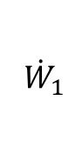
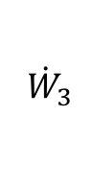

$${\dot{W}}_{1}$$
Energy Block
Delivery Network
$$H_{1},S_{1},T_{1}$$
$$\dot{Q}, {\dot{W}}_{2}$$
Sea / Surface Source
$$H_{2},S_{2},T_{2}$$
Desalination
$$H_{3},S_{3},T_{3}$$
Available Energy Recovery
Discharge Network
$$H,S_{5},T_{5}$$
$$H_{4},S_{4},T_{4}$$
$${\dot{W}}_{3}$$

Slide 3
Definition of water source
Salinity
Surface temperature
Assumed to be infinite source/sink – salinity and temperatures do not change due to operation of desalination plant
Salinity, surface temperature are assumed as a function of location and time of day (needs to be linked to the advisory model)

Slide 4
Discharge and Delivery Network
Each assumes 5km standard piping network
Losses computed: drag, (heat loss over length can be incorporated)
Pumping loss and entropy generated in pumping is calculated using relations given in literature at constant pump mechanical efficiency
In absence of energy recovery, exit streams from desalination are allowed to enter the free streams
$p2$ is calculated based on the pressure drop in the piping network >> at atmospheric temperature of operation, exergy destruction in the pipe+pump system can be easily estimated

Slide 5
Energy block
Operates as a black box initially, only provides Q and W required for desalination and pumping network
Thermal efficiencies are included in each networks
Needs to be replaced by waveguide – receiver model coupled to advisory model for location and time of day dependency

Slide 6
Desalination
Desalination techniques considered:
DCMD, AGMD - considers 2 competing technologies, one with higher yield lower efficiency, the other with higher efficiency at the cost of lower yield
RO – single stage RO (Could be scaled to multi-stage RO, needs more work for pressure recovery system in multi-staging)
MSF – Multi-staging can be changed to see parametric variations, although we can use a single combination for comparison
VCC – Vacuum compression desalination (models are available, needs more work to be coupled to FO)
Coupled MD-FO - Needs entropy characterization analysis to be coupled to the system level model

Slide 7
Energy recovery
Energy recovery block at the moment assumes a heat exchanger with constant thermal efficiency
It can incorporate commercial heat exchangers directly for cost/efficiency considerations
It can be dropped altogether to reduce complexity of the model

Slide 8
Exergy calculations
Exergy calculations performed per references used for the previous Desal paper (Sharqawy et al.)
Overall system level exergetic efficiency is calculated as the ratio difference of available energies at inlet and outlet to the available energy at outlet of the system (brine + waveguide)
Calculations follow the same path previously adapted

Slide 9
Current state of modeling
Completed:
DCMD
AGMD
MSF
Delivery / discharge networks
Energy Recovery
Needs more work:
VCC
RO
MD + FO
Chilling desalination

Slide 10
Projected timeline
Desalination Modeling
Incorporation of all listed models by Saturday Dec. 3, 2016
Additional work on models by Saturday Dec. 10, 2016
Exergy Analysis Code (includes calculations for availabilities and properties of seawater)
Porting old Matlab code to Python by Thursday Dec. 1, 2016
Projected overall completion of all blocks: Saturday Dec. 10, 2016

Slide 11
Calculation of properties
Calculation of state variables :
Specific volume, specific entropy, specific enthalpy, specific gibb’s free energy, specific chemical potential
Entropy generation
Enthalpy loss (kinetic energy loss)

Slide 12
Models

Slide 13
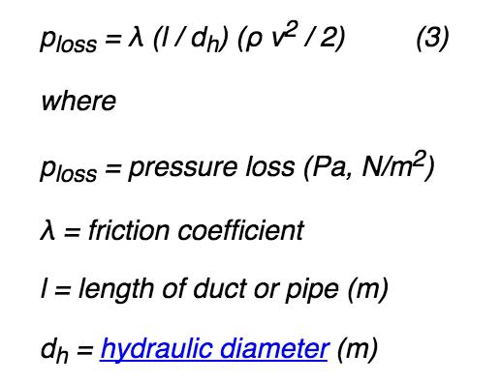
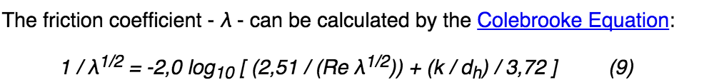
Pipe loss
Calculate Re, and dh from mass flow requirements. Use standard length. Substitue Re, dh in (9) to solve for lambda iteratively. Substitute lambda in (3) to calculate pressure drop.
Use the pressure drop for overpressure calculation, forward overpressure to pump.

Slide 14
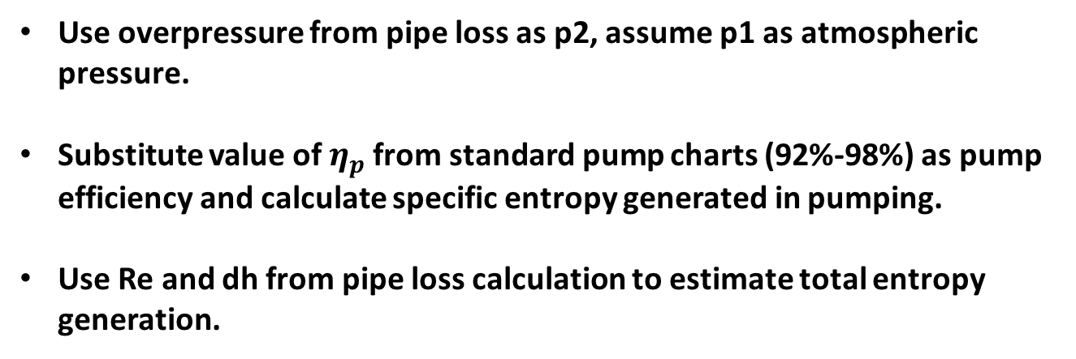
Pump
Use overpressure from pipe loss as p2, assume p1 as atmospheric pressure.
Substitute value of $η_{p}$ from standard pump charts (92%-98%) as pump efficiency and calculate specific entropy generated in pumping.
Use Re and dh from pipe loss calculation to estimate total entropy generation.

Slide 15
Heat exchanger
Calculate T2 from exit temperature of desal
Assume T1 to be the reservoir temperature/ambient temperature and calculate specific entropy generation
Massflow rates of the interacting streams depend on the desal technique, substitute corresponding to hot streams

Slide 16
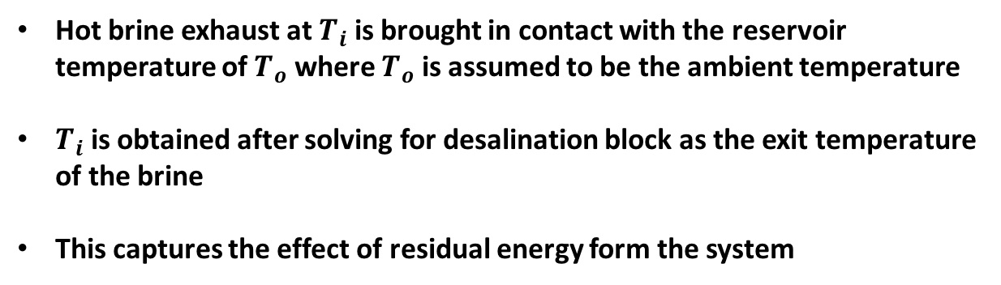
Thermal dis-equilibrium
Hot brine exhaust at $T_{i}$ is brought in contact with the reservoir temperature of $T_{o}$ where $T_{o}$ is assumed to be the ambient temperature
$T_{i}$ is obtained after solving for desalination block as the exit temperature of the brine
This captures the effect of residual energy form the system

Slide 17
Chemical-disequilibrium
This is a fundamental issue that has rarely been address in depth
We can calculate the entropy generated due to mixing between highly concentrated brine with the ocean waters
We might need to perform a sensitivity analysis to understand the effect of reservoir mass, in theory it will tend to infinity.
It solves for Gibb’s free energy balance between the interacting streams to find out the available energy destruction due to mixing

Slide 18
MED
Stages in MED are treated as a variable
Intermediate brine temperature is limited to 65 degree C as worked out in the example
Overall heat transfer coefficient is assumed to be the same as from the worked out example
Salinities are treated as a variable
Output and stream mass flow rates are variables and are calculated based on plant size

Slide 19
RO
RO calculations strongly depend on mass fractions
Pressure variation is neglected since it has been showed that properties do not vary with pressure significantly in operational temperature-pressure range
At the moment model includes only a single stage system
There is a room for multi-stage model inclusion

Slide 20
AGMD, DCMD
Standard network models are implemented using heat transfer resistances in each elements
Total heat transfer loss is calculated based on conduction+convection
Total mass flow rate is estimated based on absolute transmembrane temperature difference (correlating to vapor pressure difference to give mass transfer)
Linear models are used to predict Q and m
Q is used to estimate entropy generation in the parasitic heat transfer

Slide 21
Stuff to be finished yet
VCC – Vacuum compression desalination (models are available, needs more work to be coupled to FO)
Coupled MD-FO - Needs entropy characterization analysis to be coupled to the system level model
Freezing desalination
Additional comments: All models listed above are tested, values checked with respective papers.
Individual components are functioning properly, haven’t connected them all together yet. My plan is to finish the above 3 blocks, and then create a unified network. (don’t need to connect them separately for every system. It will be something like a global model.

Slide 22
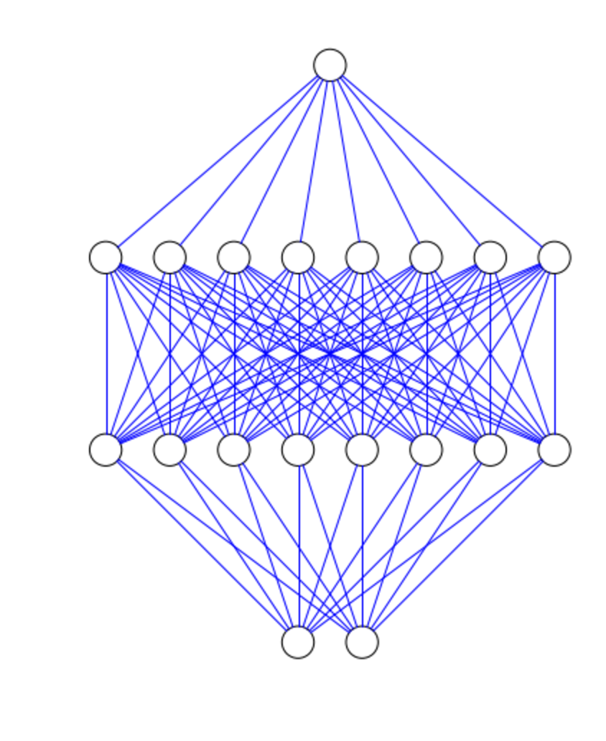
Idea for network diagram
Python has a package to create network diagrams, I am thinking we could use it to generate networks as you go on adding individual blocks
This falls in line with the tool development, as the designer goes on adding blocks or changing values, the network will reflect the changes in visual sense

Slide 23
Verification of MEB model
 | T | t | F | Df | Db | D | B | X | Ae | Af
0.00 | 65.00 | 62.00 | 384.92 | 0.00 | 11.86 | 11.86 | 373.06 | 47.46 | 7202.44 | 0.00
1.00 | 62.55 | 59.55 | 373.06 | 1.62 | 10.19 | 11.81 | 361.25 | 49.01 | 5448.30 | 474.21
2.00 | 60.09 | 57.09 | 361.25 | 1.57 | 10.19 | 11.76 | 349.49 | 50.66 | 5448.30 | 474.21
3.00 | 57.64 | 54.64 | 349.49 | 1.52 | 10.19 | 11.71 | 337.78 | 52.42 | 5448.30 | 474.21
4.00 | 55.18 | 52.18 | 337.78 | 1.47 | 10.19 | 11.66 | 326.12 | 54.29 | 5448.30 | 474.21
5.00 | 52.73 | 49.73 | 326.12 | 1.42 | 10.19 | 11.61 | 314.52 | 56.30 | 5448.30 | 474.21
6.00 | 50.27 | 47.27 | 314.52 | 1.37 | 10.19 | 11.56 | 302.96 | 58.45 | 5448.30 | 474.21
7.00 | 47.82 | 44.82 | 302.96 | 1.32 | 10.19 | 11.51 | 291.45 | 60.75 | 5448.30 | 474.21
8.00 | 45.36 | 42.36 | 291.45 | 1.27 | 10.19 | 11.46 | 280.00 | 63.24 | 5448.30 | 474.21
9.00 | 42.91 | 39.91 | 280.00 | 1.22 | 10.19 | 11.41 | 268.59 | 65.92 | 5448.30 | 474.21
10.00 | 40.45 | 37.45 | 268.59 | 1.17 | 10.19 | 11.36 | 257.23 | 68.83 | 5448.30 | 474.21
11.00 | 38.00 | 35.00 | 257.23 | 5.47 | 10.19 | 15.66 | 241.57 | 73.30 | 5448.30 | 474.21
Reproduced
Original

